Slide 1
Cornerstone City Church Peninsula Plus Community Hoo Are Ya 04-06-2023

Slide 2
House Of The Lord
CCLI Song # 7168995
© 2020 Phil Wickham MusicSimply Global SongsBe Essential SongsCashagamble Jet Music
For use solely with the SongSelect® Terms of Use. All rights reserved. www.ccli.com
Note: Reproduction of this sheet music requires a CCLI Music Reproduction Licence. Please report all copies.
CCLI Licence No. 33265

Slide 3
1/5
We worship the God who was
We worship the God who is
We worship the God who evermore will be
He opened the prison doors
He parted the raging sea
My God He holds the victory yeah

Slide 4
2/5
There’s joy in the house of the Lord
There’s joy in the house of the Lord today
And we won’t be quiet
We shout out Your praise

Slide 5
3/5
There’s joy in the house of the Lord
Our God is surely in this place
And we won’t be quiet
We shout out Your praise

Slide 6
4/5
We sing to the God who heals
We sing to the God who saves
We sing to the God who always makes a way
'Cause He hung up on that cross
Then He rose up from that grave
My God’s still rolling stones away

Slide 7
5/5
We were the beggars
Now we’re royalty
We were the prisoners
Now we’re running free
We are forgiven accepted
Redeemed by His grace
Let the house of the Lord sing praise

Slide 8
Way Maker CCLI Song # 7115744
Osinachi Kalu Okoro Egbu
© 2016 Integrity Music Europe (Admin. by Integrity Music)
For use solely with the SongSelect® Terms of Use. All rights reserved. www.ccli.com
CCLI Licence No. 33265

Slide 9
1/4
You are here moving in our midst I worship You I worship You You are here working in this place I worship You I worship You
(You are) Way Maker Miracle Worker Promise Keeper Light in the darkness my God that is who You are

Slide 10
2/4
You are here touching ev'ry heart I worship You I worship You You are here healing ev'ry heart I worship You I worship You
(You are) Way Maker Miracle Worker Promise Keeper Light in the darkness my God that is who You are

Slide 11
You are here turning lives around I worship You I worship You You are here mending ev'ry heart I worship You yeah I worship You Lord
(You are) Way Maker Miracle Worker Promise Keeper Light in the darkness my God that is who You are
3/4

Slide 12
That is who You are x4
Even when I don't see it You're working Even when I don't feel it You're working You never stop You never stop working x2
4/4

Slide 13
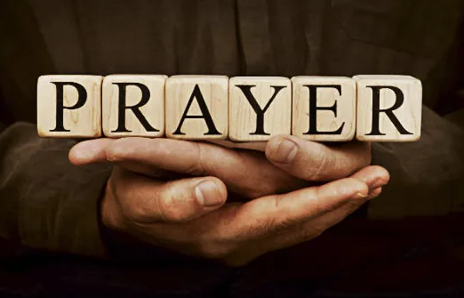

Slide 14
Goodness Of God
CCLI Song # 7117726
Ben Fielding | Brian Johnson | Ed Cash | Jason Ingram | Jenn Johnson
© 2018 Capitol CMG Paragon (Admin. by Capitol CMG Publishing)
Fellow Ships Music (Admin. by Essential Music Publishing LLC)
So Essential Tunes (Admin. by Essential Music Publishing LLC)
SHOUT! Music Publishing Australia (Admin. by SHOUT! Music Publishing UK)
Bethel Music Publishing (Admin. by Song Solutions)
For use solely with the SongSelect® Terms of Use. All rights reserved. www.ccli.com
CCLI Licence No. 33265

Slide 15
1/4
I love You Lord
Oh Your mercy never fails me
All my days
I've been held in Your hands
From the moment that I wake up
Until I lay my head
I will sing of the goodness of God

Slide 16
2/4
All my life You have been faithful
All my life You have been so so good
With every breath that I am able
I will sing of the goodness of God

Slide 17
3/4
I love Your voice
You have led me through the fire
In darkest night
You are close like no other
I've known You as a father
I've known You as a friend
I have lived in the goodness of God

Slide 18
4/4
Your goodness is running after
It’s running after me
Your goodness is running after
It’s running after me
With my life laid down
I’m surrendered now
I give You everything
Your goodness is running after
It's running after me

Slide 20
Holy Forever
CCLI Song # 7201044
Brian Johnson | Chris Tomlin | Jason Ingram | Jenn Johnson | Phil Wickham
© Phil Wickham Music (Admin. by / Small Stone Media BV, Holland (Admin. in the UK/Eire by Song Solutions www.songsolutions.org))
Simply Global Songs (Admin. by / Small Stone Media BV, Holland (Admin. in the UK/Eire by Song Solutions www.songsolutions.org))
Capitol CMG Paragon (Admin. by Capitol CMG Publishing)
S. D. G. Publishing (Admin. by Capitol CMG Publishing)
Be Essential Songs (Admin. by Essential Music Publishing LLC)
My Magnolia Music (Admin. by Essential Music Publishing LLC)
Bethel Music Publishing (Admin. by Song Solutions)
Brian and Jenn Publishing (Admin. by Song Solutions)
For use solely with the SongSelect® Terms of Use. All rights reserved. www.ccli.com
CCLI Licence No. 33265

Slide 21
1/10
A thousand generations falling down in worship
To sing the song of ages to the Lamb
And all who've gone before us
And all who will believe
Will sing the song of ages to the Lamb

Slide 22
2/10
(Jesus) Your name is the highest
Your name is the greatest
Your name stands above them all
All thrones and dominions
All powers and positions
Your name stands above them all

Slide 23
3/10
And the angels cry Holy
All creation cries Holy
You are lifted high Holy
Holy forever

Slide 24
4/10
If you've been forgiven and if you've been redeemed
Sing the song forever to the Lamb
If you walk in freedom and if you bear His name
Sing the song forever to the Lamb
We'll sing the song forever and amen

Slide 25
5/10
And the angels cry Holy
All creation cries Holy
You are lifted high Holy
Holy forever

Slide 26
6/10
Hear Your people sing Holy
To the King of Kings Holy
You will always be Holy
Holy forever

Slide 27
7/10
(Jesus) Your name is the highest
Your name is the greatest
Your name stands above them all
All thrones and dominions
All powers and positions
Your name stands above them all

Slide 28
8/10
And the angels cry Holy
All creation cries Holy
You are lifted high Holy
Holy forever

Slide 29
9/10
Hear Your people sing Holy
To the King of Kings Holy
You will always be Holy
Holy forever

Slide 30
10/10
You will always be Holy
Holy forever

Slide 31


Slide 32
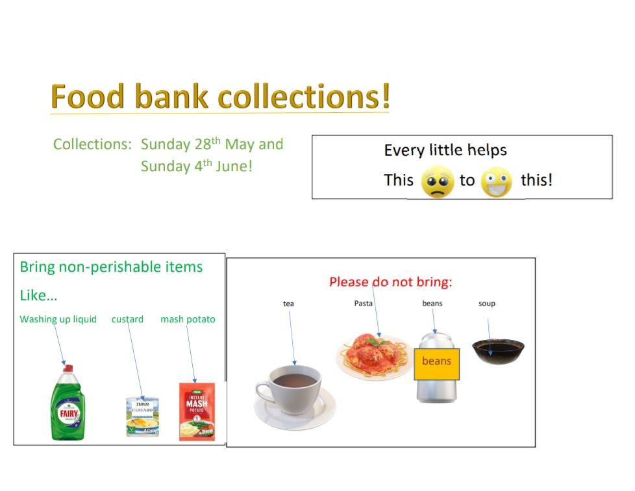

Slide 33
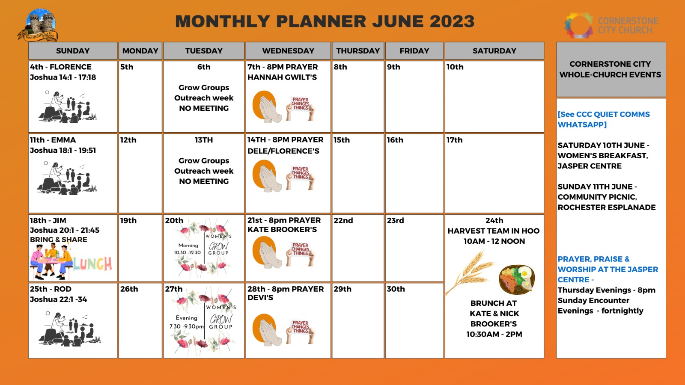

Slide 34


Slide 35
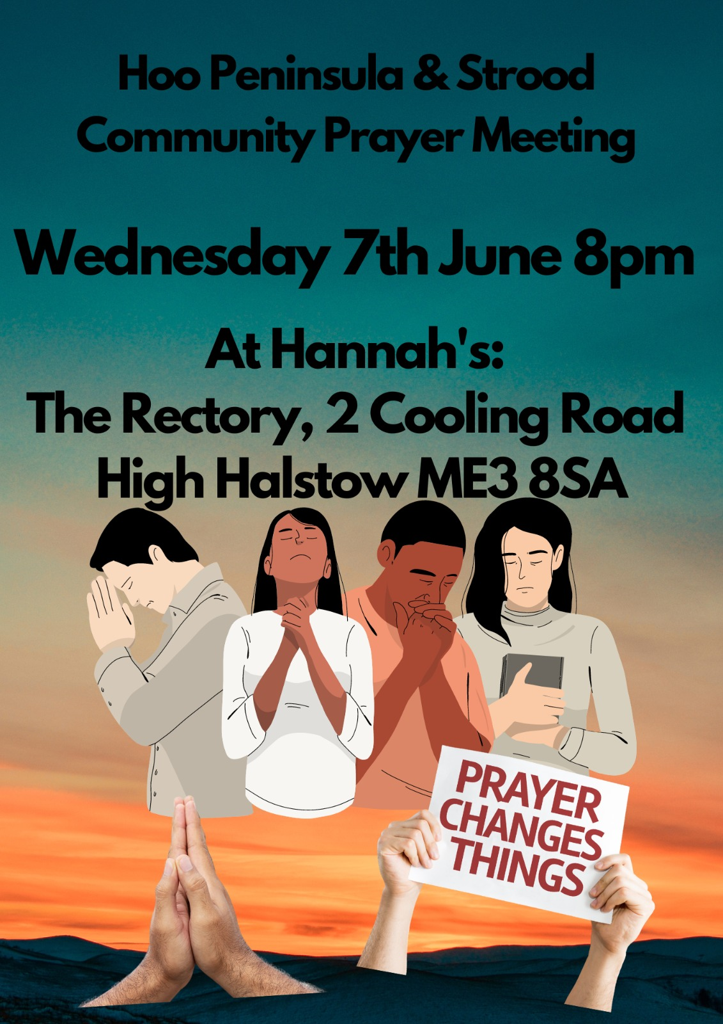

Slide 36


Slide 37


Slide 38


Slide 39


Slide 40
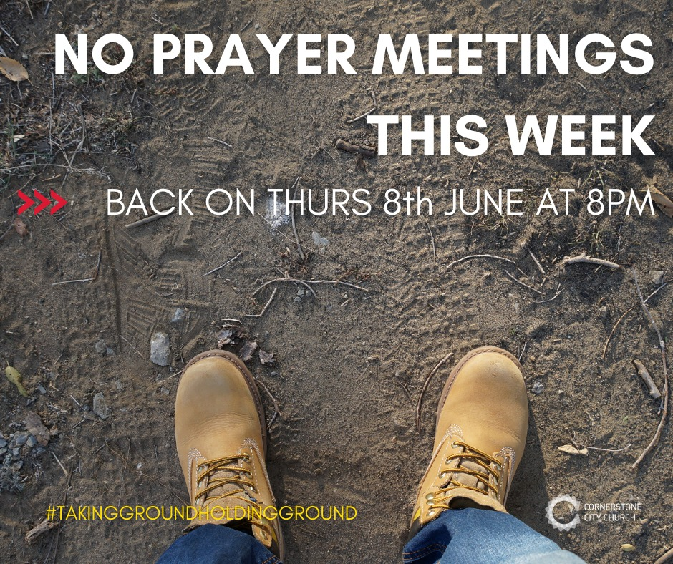

Slide 41


Slide 42


Slide 44


Slide 45
Taking Possession, Pushing Past the Boundaries
Taking Ground Series Joshua 14, 15, 16 & 17

Slide 46
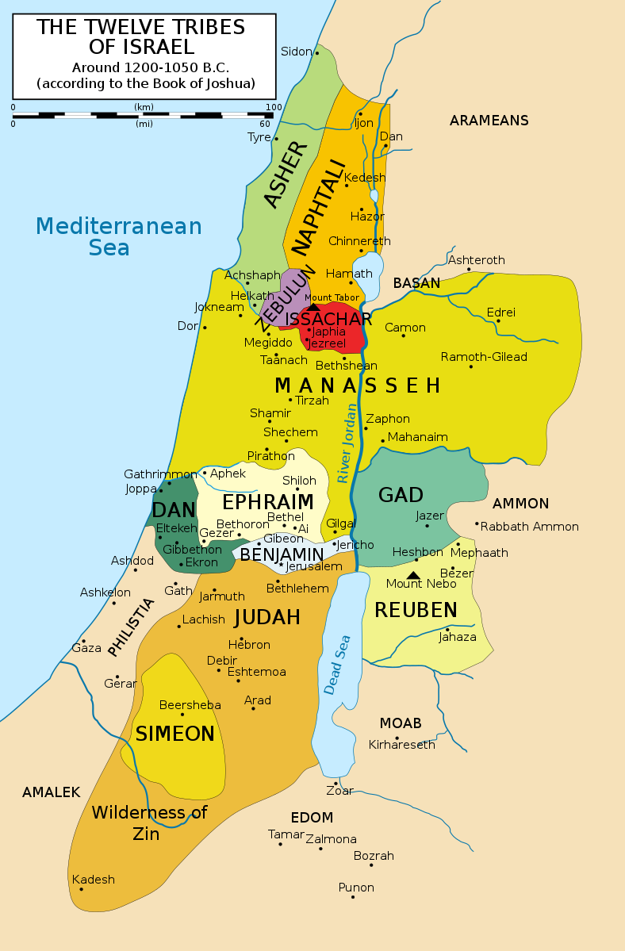
Four stories of people taking possession

Slide 47
Joshua 14: 9-13 – Caleb’s inheritance
So on that day Moses swore to me, ‘The land on which your feet have walked will be your inheritance and that of your children forever, because you have followed the Lord my God wholeheartedly.’^{[a]}
¹⁰ “Now then, just as the Lord promised, he has kept me alive for forty-five years since the time he said this to Moses, while Israel moved about in the wilderness. So here I am today, eighty-five years old! ¹¹ I am still as strong today as the day Moses sent me out; I’m just as vigorous to go out to battle now as I was then.
¹² Now give me this hill country that the Lord promised me that day. You yourself heard then that the Anakites were there and their cities were large and fortified, but, the Lord helping me, I will drive them out just as he said.”
¹³ Then Joshua blessed Caleb son of Jephunneh and gave him Hebron as his inheritance.
Notes:
Verse 9-11 Caleb reminds Joshua of God’s promise through him.
Verse 12 he asks
Verse 13 he gets
Note Joshua a single individual gets a whole city in reward
But look at how long he’s had to wait! 45 years.

Slide 48
Joshua 14: Caleb gets a portion of Judah
He reminds God of his promises
He asks in faith
He receives by faith
And remember, just because you haven’t seen the manifestation of God’s word, doesn’t mean it’s not coming, or God hasn’t answered.
Notes:
Hebron also known as Kiriatharba was Caleb’s inheritance for his loyalty and faithfulness to God and Joshua.
But Caleb still has to possess it and he does so with fervour, offering an incentive to whoever helps him defeat it, and so gets a whole city for himself.

Slide 49
Joshua 15: 13 – 19 Aksah’s inheritance
13 In accordance with the Lord’s command to him, Joshua gave to Caleb son of Jephunneh a portion in Judah—Kiriath Arba, that is, Hebron. (Arba was the forefather of Anak.) 14 From Hebron Caleb drove out the three Anakites—Sheshai, Ahiman and Talmai, the sons of Anak. 15 From there he marched against the people living in Debir (formerly called Kiriath Sepher). 16 And Caleb said, “I will give my daughter Aksah in marriage to the man who attacks and captures Kiriath Sepher.” 17 Othniel son of Kenaz, Caleb’s brother, took it; so Caleb gave his daughter Aksah to him in marriage.
18 One day when she came to Othniel, she urged him[a] to ask her father for a field. When she got off her donkey, Caleb asked her, “What can I do for you?”
19 She replied, “Do me a special favor. Since you have given me land in the Negev, give me also springs of water.” So Caleb gave her the upper and lower springs.
Notes:
Preamble:
Hebron also known as Kiriatharba was Caleb’s inheritance for his loyalty and faithfulness to God and Joshua.
But Caleb still has to possess it and he does so with fervour, offering an incentive to whoever helps him defeat it, and so gets a whole city for himself.
Caleb’s incentive is his daughter.
Aksah approaches her husband and asks him to ask her father for a field.
Conversation might go something like this:
Aksah: That stupid well has dried up again. We have no water for cooking!
Othniel: What do you want me to do about it. I’m not God. Even if we dig another well it’s still going to take time.
Aksah: My dad owns the city. Why not ask him for some land with a spring on it.
Othniel: He’s your dad. Why can’t you ask him?
Aksah: Okay, as long as I have your permission to do so. (Some bible translations of verse 18 indicate she asked her husband permission to approach her father.)
Remember women were owned by their fathers then their husbands so she had to have his permission to ask her dad.
So off she goes.
It’s a simple conversation she has with her dad:
She reminds him he’s already given her land – and acknowledges she is about to ask a special favour. Now women didn’t own land and we don’t know the circumstances surrounding her getting it but it was probably her dowry to her husband.
Then she asks for springs. Note the plural! Why settle for one when you can have 2?
And he says here you are!
What does this remind you of? Aksah learnt from the best. She saw how her dad received Hebron and she’s emulating him. Do your children emulate you in good and effective ways?
It was a brave thing to go and ask for more. But she trusted in her father’s love. She asked and she received.

Slide 50

Joshua 15: Aksah’s gets some springs
Aksah reminded her father of his previous expression of love
She acknowledges her appreciation of what she is about to receive
She asks
She gets!

Slide 51
Joshua 17: 1-4 - Manasseh’s inheritance Part 1
17 This was the allotment for the tribe of Manasseh as Joseph’s firstborn, that is, for Makir, Manasseh’s firstborn. Makir was the ancestor of the Gileadites, who had received Gilead and Bashan because the Makirites were great soldiers. 2 So this allotment was for the rest of the people of Manasseh—the clans of Abiezer, Helek, Asriel, Shechem, Hepher and Shemida. These are the other male descendants of Manasseh son of Joseph by their clans.
3 Now Zelophehad son of Hepher, the son of Gilead, the son of Makir, the son of Manasseh, had no sons but only daughters, whose names were Mahlah, Noah, Hoglah, Milkah and Tirzah. 4 They went to Eleazar the priest, Joshua son of Nun, and the leaders and said, “The Lord commanded Moses to give us an inheritance among our relatives.” So Joshua gave them an inheritance along with the brothers of their father, according to the Lord’s command.
Notes:
Here we see women pushing boundaries never crossed before.
As said previously, women did not inherit land. But Zelophehad’s daughters argued that if they were not given land, their father’s name would be lost to the clan. They understood the law and were willing to fight for their rights.
The story continues in Numbers 36:5–11.
The girls’ uncles were not happy at Moses’ edict. Their problem was if the girls married men from other tribes, the land would transfer to their husbands thus enriching the husbands, to the detriment of their clan.
Moses takes it to God in prayer and comes back with a response. God commands that they must marry men within their tribe so their inheritance stays within the tribe.
What God has given you cannot be taken away.

Slide 52
Numbers 27: 1:8 - The story fleshed out
27 The daughters of Zelophehad son of Hepher, the son of Gilead, the son of Makir, the son of Manasseh, belonged to the clans of Manasseh son of Joseph. The names of the daughters were Mahlah, Noah, Hoglah, Milkah and Tirzah. They came forward 2 and stood before Moses, Eleazar the priest, the leaders and the whole assembly at the entrance to the tent of meeting and said, 3 “Our father died in the wilderness. He was not among Korah’s followers, who banded together against the Lord, but he died for his own sin and left no sons. 4 Why should our father’s name disappear from his clan because he had no son? Give us property among our father’s relatives.”
5 So Moses brought their case before the Lord, 6 and the Lord said to him, 7 “What Zelophehad’s daughters are saying is right. You must certainly give them property as an inheritance among their father’s relatives and give their father’s inheritance to them.
8 “Say to the Israelites, ‘If a man dies and leaves no son, give his inheritance to his daughter. 9 If he has no daughter, give his inheritance to his brothers. 10 If he has no brothers, give his inheritance to his father’s brothers. 11 If his father had no brothers, give his inheritance to the nearest relative in his clan, that he may possess it. This is to have the force of law for the Israelites, as the Lord commanded Moses.’”
Notes:
The story of Korah is found in Numbers 16. Korah led a revolt against Moses; he died, along with all his co-conspirators, when God caused "the earth to open her mouth and swallow him and all that appertained to them" (Numbers 16:31-33). Immediately after this event, the Lord’s anger burned and a plague struck killing another 14,700 Israelites.

Slide 53
Joshua 17: 1-4 - The Five Daughters of Zelophehad
They reminded Joshua and the priests of God’s promise.
They were confident of what was theirs to claim
They asked
They received
Their boldness brought change for all Israelite women.

Slide 54
Joshua 17: 5 - 17 Manasseh’s inheritance Part 2
5 Manasseh’s share consisted of ten tracts of land besides Gilead and Bashan east of the Jordan, 6 because the daughters of the tribe of Manasseh received an inheritance among the sons. The land of Gilead belonged to the rest of the descendants of Manasseh.
7 The territory of Manasseh extended from Asher to Mikmethath east of Shechem. The boundary ran southward from there to include the people living at En Tappuah. 8 (Manasseh had the land of Tappuah, but Tappuah itself, on the boundary of Manasseh, belonged to the Ephraimites.) 9 Then the boundary continued south to the Kanah Ravine. There were towns belonging to Ephraim lying among the towns of Manasseh, but the boundary of Manasseh was the northern side of the ravine and ended at the Mediterranean Sea. 10 On the south the land belonged to Ephraim, on the north to Manasseh. The territory of Manasseh reached the Mediterranean Sea and bordered Asher on the north and Issachar on the east.
11 Within Issachar and Asher, Manasseh also had Beth Shan, Ibleam and the people of Dor, Endor, Taanach and Megiddo, together with their surrounding settlements (the third in the list is Naphoth[a]).
12 Yet the Manassites were not able to occupy these towns, for the Canaanites were determined to live in that region. 13 However, when the Israelites grew stronger, they subjected the Canaanites to forced labor but did not drive them out completely.

Slide 55
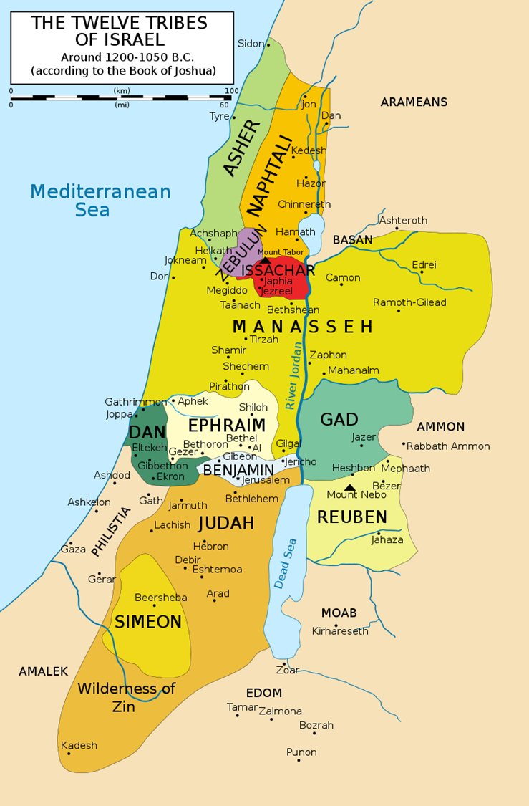
14 The people of Joseph said to Joshua, “Why have you given us only one allotment and one portion for an inheritance? We are a numerous people, and the Lord has blessed us abundantly.”
15 “If you are so numerous,” Joshua answered, “and if the hill country of Ephraim is too small for you, go up into the forest and clear land for yourselves there in the land of the Perizzites and Rephaites.”
16 The people of Joseph replied, “The hill country is not enough for us, and all the Canaanites who live in the plain have chariots fitted with iron, both those in Beth Shan and its settlements and those in the Valley of Jezreel.”
17 But Joshua said to the tribes of Joseph—to Ephraim and Manasseh—“You are numerous and very powerful. You will have not only one allotment 18 but the forested hill country as well. Clear it, and its farthest limits will be yours; though the Canaanites have chariots fitted with iron and though they are strong, you can drive them out.”
Notes:
Given how easily Joshua gave into the request of Caleb and the daughters of Zelophehad, why did he say no to the Manassites?
Revisit the map and the land apportioned to Manasseh.
Note that the tribe of Joseph had already been split into two Ephraim and Manasseh so technically they were already getting more than a fair share- given land as if they were a whole tribe rather than a half tribe.

Slide 56
What separates the last story from the first three?
A sense of entitlement not backed with a willingness to do the work
No thankfulness
Fear or Laziness?
Lack of faith
WARNING!
Do not let your privilege make you lazy!
Do not ask out of greed.
James 4:3
³ When you ask, you do not receive, because you ask with wrong motives, that you may spend what you get on your pleasures.
Notes:
Compare Caleb’s attitude to taking his territory to Manasseh’s children. But with the Lord helping me.
Or with Caleb’s daughter who appreciated what she had and came with reverence and humility.
Or the daughter’s of Zelophedad who had a legal claim.
Theirs was just a case of Oliver twist but they weren’t even hungry to start with.
Fear or laziness? Remember they were supposed to be great soldiers Joshua 17:1, but got too weak from a fat life? to drive out the people they were supposed to drive out. Eventually mustering enough strength to subdue them, allowing them to stay and do their menial work – privileged lot?
Compare that to Caleb who said, ‘who’s gonna help me drive out these people and here’s a wife to sweeten the deal.’
They showed no faith in the God who they know had enriched and multiplied them thus far and his ability to help them conquer the forest Joshua sent them to. Instead, they whinged.

Slide 57
Taking Territory: Principles to remember
God keeps his promises
It’s important to know and remember what God has promised you
Remind him of it and ask accordingly to his will
Receive it by faith
Then put in the work!
Be patient
And you shall receive
Notes:
These principles apply whether we are trying to win souls for Christ on in the daily intricacies of our lives
Joshua 21 : 45 ⁴⁵ Not one of all the Lord’s good promises to Israel failed; every one was fulfilled.
Isaiah 43:26 Says: Review the past for me, let us argue the matter together; God’s happy for us to remind him of what he’s said.
John 15:7 “If you abide in me, and my words abide in you, ask whatever you wish, and it will be done for you.”
Matthew 21:22 - And whatever you ask in prayer, you will receive, if you have faith.
James 2:14-26 – Faith without works is dead.
John 16:24 Until now you have asked for nothing in My name; ask and you will receive, so that your joy may be made full.

